Slide 1
E-Commerce Customer Segmentation
and Prediction

Slide 2

Agenda
1. Introduction and Objectives
Problem Statement
Business Objectives
Expected Outcomes
2. Data Methodology
Data Collection and Sources
Key Data Insights
Segmentation Methodology
Churn Prediction Methodology
Feature Engineering
AGENDA

Slide 3
Agenda
3. Customer Segmentation Results
Customer Segmentation Overview
Segment Profiles
Actionable Segment Strategies
4. Churn Prediction Results
Churn Prediction Model Overview
Key Drivers of Churn
Customer Churn Risk Levels.
5. Visualization and Deployment
Dashboard Overview
Deployment of Churn Model
AGENDA

Slide 4
Agenda
Future Enhancement
Conclusion
AGENDA

Slide 5
INTRODUCTION
E-commerce, or electronic commerce, refers to the buying and selling of goods and services over the internet. It has transformed the traditional retail landscape, allowing businesses to reach global markets and operate 24/7 without the limitations of a physical store.
With the rapid growth of digital technology and increased internet accessibility, e-commerce has become an integral part of modern business, providing consumers with a convenient and personalized shopping experience.

Slide 6

PROBLEM STATEMENT
In an increasingly competitive e-commerce landscape, understanding and predicting customer behavior is essential to drive targeted marketing, improve retention, and manage resources efficiently.
Currently, the company lacks a precise mechanism to categorize customers based on purchasing patterns, leading to generalized marketing strategies that may not resonate with different customer segments.
This gap results in missed opportunities for customer engagement, suboptimal resource allocation, and potential revenue loss from unsatisfied or inactive customers.
Notes:
E-commerce Customer Segmentation and Prediction
Develop a robust customer segmentation model and a predictive classifier to categorize customers based on their purchasing patterns. This will enable the company to tailor marketing strategies, improve customer retention, and optimize inventory management.

Slide 7
OBJECTIVE OF THIS PROJECT
The objective of this project is to develop a machine learning-based solution that segments customers according to their purchasing behaviors and predicts future purchasing tendencies
By accurately segmenting customers, predicting churn likelihood, and pinpointing those who may need incentives for further engagement, the company can implement targeted retention and personalized marketing strategies.
This approach will enhance customer satisfaction, foster loyalty, and drive repeat purchases while ensuring efficient resource allocation and optimized marketing strategies.

Slide 8
EXPECTED OUTCOMES
Customer Segmentation Insights
Churn Prediction Model
Enhanced Marketing Efficiency
Increased Revenue Potential
Notes:
Customer Segmentation Insights:
Clear identification and categorization of customer segments based on purchasing behavior, allowing the marketing team to understand distinct characteristics and needs of each group.
Churn Prediction Model:
A robust model capable of identifying customers at risk of churning, enabling the company to implement timely, targeted retention strategies to reduce churn rates and enhance customer lifetime value.
Enhanced Marketing Efficiency:
Targeted marketing strategies for each customer segment, focusing on high-value and high-risk groups, optimizing budget allocation and maximizing return on marketing investment.
Increased Revenue Potential:
Boosted revenue through reduced churn rates and increased repeat purchases, driving overall profitability by nurturing long-term customer relationships.

Slide 9
DATA AND METHOLOGY

Slide 10
DATA SUMMARY
The dataset consists of 8 attributes that provide crucial insights into customer transactions in a retail setting.
Each attribute plays a vital role in analyzing purchasing patterns, customer behavior, and inventory management.
Sno | Attribute | Description
1 | InvoiceNo | Unique identifier for each invoice, representing a specific transaction.
2 | StockCode | Unique code for each product in stock, useful for tracking individual items in inventory.
3 | Description | Text description of the product, providing the product name or additional details about the item.
4 | Quantity | Number of units purchased per item, helpful for understanding sales volume and stock depletion.

Slide 11
DATA SUMMARY (cont…)
5 | InvoiceDate | Date and time when the invoice was generated, crucial for tracking sales trends and seasonality.
6 | UnitPrice | Price per unit of the product, essential for calculating total transaction amounts and revenue.
7 | CustomerID | Unique identifier for each customer, allowing for individual customer tracking and behavior analysis.
8 | Country | Country of the customer or purchase location, aiding in geographic sales analysis and segmentation.

Slide 12
DATA CLEANING AND PREPROCESSING TECHNIQUES
Missing Values:
Identified and imputed or removed missing data in fields like CustomerID and Description to ensure data.
Removing Duplicates:
Eliminated duplicate records, especially in InvoiceNo and CustomerID,to maintain data accuracy.
Data Type Conversion:
Converted fields such as InvoiceDate to datetime and Quantity to numerical types to enable proper computations.
Feature Scaling:
Applied scaling to numerical attributes like Quantity and UnitPrice for consistency in analysis and modeling.
Creating New Features:
Derived features such as TotalPrice (Quantity * UnitPrice) to enhance transaction value insights.
Feature Engineering:
Extracted components like month and day of the week from InvoiceDate to analyze seasonal trends and patterns.

Slide 13
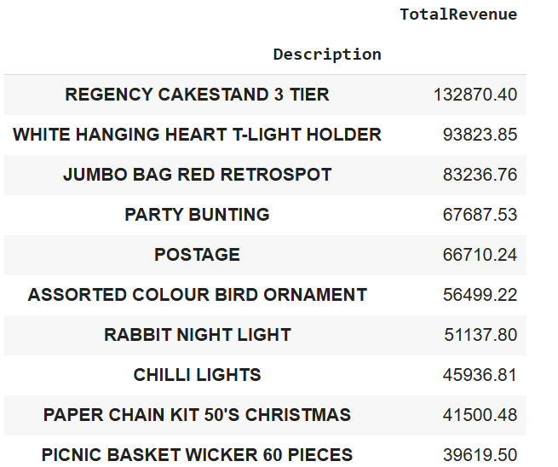
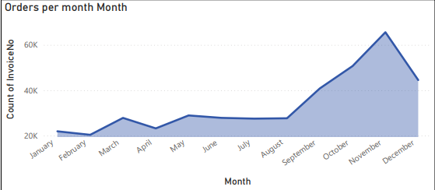
Key Data Insights:
High Revenue Generating Products:
Identified the top products Contributing to overall revenue through analysis of Total Price and Quantity sold, This Indicate the key items to focus on for Further Sales
Sales Seasonality:
Observed that certain months and days show increased sales, highlighting seasonal demand patterns that can guide inventory and promotional strategies.

Slide 14

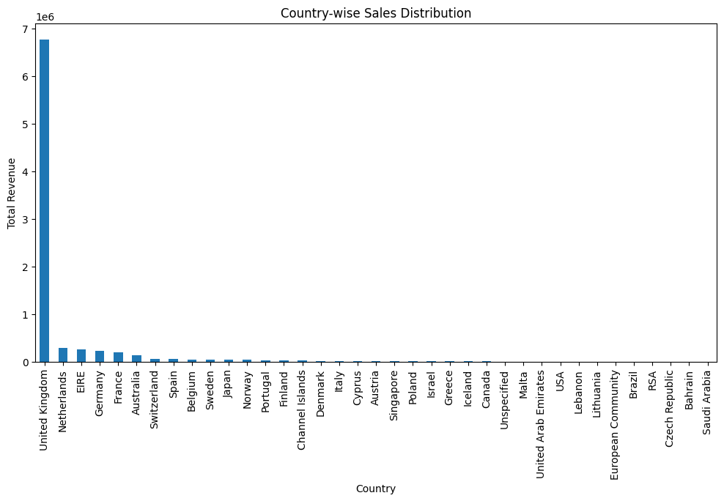
Key Insights (cont…)
Customer Purchase:
Patterns Noticed distinct purchasing trends, such as peak shopping periods and frequency of repeat purchases by specific Customer IDs, useful for targeted marketing.
Country-wise Sales Distribution:
Sales primarily concentrated in a few countries, with the highest volume observed in the UK, presenting opportunities for geographical expansion.

Slide 15
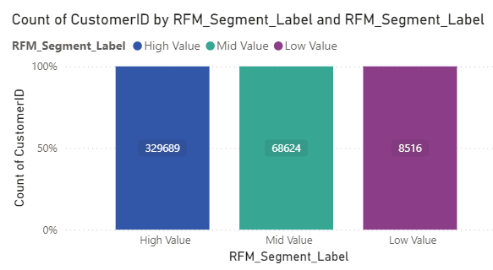
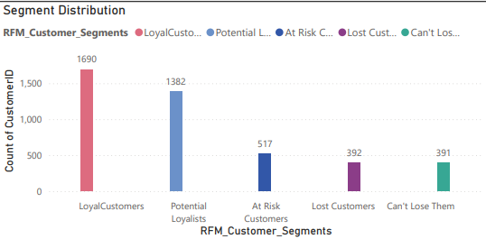
Key Insights (cont…)
High-Value Customer Segments
Identified customers with
High values,
Mid values,
Low values
base on Recency, Frequency, Monetary Values.
They are further segments as
Loyal Customer
Potential Customer
At Risk Customer
Lost Customer
Can’t Loose Them
useful for loyalty programs and customer retention strategies.

Slide 16
FEATURE ENGINEERING:
Key Behavioral Features: Important features were engineered to capture customer behavior patterns, improving model performance and interpretability:
Recency, Frequency, Monetary (RFM) Analysis features were derived to assess the likelihood of future purchases:
Frequency
Monetary
Recency
measures time since the last purchase, indicating engagement levels.
counts the total purchases, capturing repeat customer value.
calculates total spending, which reflects customer value.

Slide 17
METHODOLOGY OVERVIEW:
Clustering Techniques for Segmentation: To identify distinct customer segments, clustering techniques were employed. Specifically:
K-means Clustering was used to partition customers into groups based on their purchasing patterns, allowing for tailored marketing strategies
Hierarchical Clustering offered insights into customer hierarchy and relationships within segments, providing a more granular view of segment
DBSCAN:
This technique identified core and noise points in the dataset, making it effective for detecting natural clusters with irregular shapes, especially useful in separating dense areas from outliers.

Slide 18
METHODOLOGY OVERVIEW:
Machine Learning Models for Churn Prediction: Several machine learning models were implemented to predict customer churn and enhance retention efforts
Random Forest provided robust performance with feature importance analysis, improving model accuracy and aiding in identifying key drivers of churn.

Slide 19
CUSTOMER SEGMENATION RESULTS
At Risk Customers
Can't Lose Them
Lost Customers
Loyal Customers
Potential Loyalists

Slide 20
OVERVIEW OF SEGMENTS
Overview of Segments: The customer base was categorized into distinct segments, each with unique characteristics to tailor marketing strategies effectively:
At Risk Customers
Customers with a declining purchase frequency who may potentially churn if not re-engaged. They show lower recent activity and could benefit from re-engagement campaigns or reminders.
Can’t Lose Them:
High-value, highly engaged customers critical to revenue, but with signs of reduced engagement. Strategic retention efforts, such as personalized outreach or exclusive perks, are crucial for this group.
Lost Customers:
Customers who haven’t made a purchase in a long time and show low engagement likelihood. Win-back campaigns or reactivation offers could help in rekindling their interest.
Regular purchasers with high engagement and brand loyalty. They respond well to loyalty rewards, exclusive offers, and brand communication, making them key to retention efforts.
Loyal Customers:
Potential Loyalist
New or occasional customers showing increasing engagement and potential for higher loyalty. Conversion efforts, such as onboarding programs or incentives, can help nurture these customers into becoming loyal patrons.

Slide 21
Tailored Marketing Stategy
At Risk Customers: Implement re-engagement campaigns like targeted discounts or personalized product recommendations.
Can’t Lose Them: Offer special incentives or exclusive perks to maintain their interest and prevent churn.
Lost Customers: Run reactivation campaigns with attractive offers to regain their interest and bring them back into active engagement.
Loyal Customers: Maintain strong engagement through loyalty programs and premium customer service, ensuring continued retention.
Potential Loyalists: Foster a relationship with incentives and personalized outreach to build loyalty and encourage repeat purchases.
Each segment benefits from tailored strategies that address their unique needs and potential to maximize engagement and lifetime value.

Slide 22
KEY DRIVERS OF CHURN
Recency: Customers who hadn’t engaged recently had a higher risk of churning, emphasizing the importance of maintaining regular contact.
Frequency: Low purchase frequency was a strong indicator of churn, with infrequent buyers showing less attachment.
Monetary Value: Customers with lower overall spending levels were likelier to churn, potentially highlighting pricing sensitivity or lack of perceived value
Frequency
Monetary
Recency

Slide 23
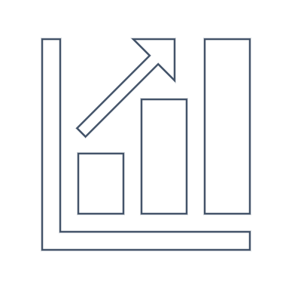
CHURN RISK LEVELS
High Churn Risk: Customers with low frequency, high recency, and low monetary value, indicating a need for retention strategies like special offers or re-engagement campaigns.
Medium Churn Risk: Customers with moderate RFM scores, where targeted loyalty programs can strengthen engagement.
Low Churn Risk: Customers with high purchase frequency, recent activity, and significant spending, suggesting low churn probability. Retention strategies should focus on satisfaction maintenance.

Slide 24
BUSINESS IMPACT AND RECOMENDATIONS
Here is breakdown for each customer segment, focusing on strategies and impacts

Slide 25
Segmentation Recommendations:
Characteristics: These customers show a decrease in engagement or purchasing frequency.
Strategy: Offer personalized incentives, such as targeted discounts or reminders of loyalty benefits, to encourage renewed engagement.
Impact: Re-engagement can prevent these customers from moving to the "Lost Customers" category, reducing churn rate.
Characteristics: High-value customers essential to revenue, showing signs of wavering loyalty.
Strategy: Implement VIP benefits like dedicated support, exclusive offers, or early product access to reinforce their importance.
Impact: Retaining these customers preserves critical revenue streams and improves brand loyalty.
Characteristics: These customers have disengaged and are no longer active.
Strategy: Attempt reactivation with special offers or limited-time discounts; consider exit surveys to understand the reasons for disengagement.
Impact: Reactivating even a small percentage can generate additional revenue and reveal insights into common churn causes.
Characteristics: Regular, repeat purchasers with high engagement and brand commitment.
Strategy: Strengthen loyalty through rewards programs, referral incentives, and exclusive previews, fostering long-term relationships.
Impact: Increasing loyalty among these customers maximizes lifetime value and boosts brand advocacy.
Characteristics: Customers with occasional purchases who could become more frequent buyers.
Strategy: Nurture this group by providing relevant product recommendations and tailored offers that encourage repeat purchases.
Impact: Converting these customers into loyal customers increases engagement and future revenue potential.
At-Risk Customers
Can't Lose Them
Lost Customers
Loyal Customers
Potential Loyalists

Slide 26
Cluster-Wise Recommendations:
Cluster 1: Diverse High-Value and At-Risk Customers
Cluster 2: Varied Engagement Levels with Churn Risks
Cluster 3: High-Value, Deeply Engaged Customers
Cluster 4: High-Frequency Past Buyers with Decreased Recent Activity
Characteristics: Previously highly engaged customers with high spending but decreased recent activity.
Recommendations: Reactivate with personalized offers, loyalty incentives, and promotional strategies to encourage re-engagement.
Characteristics: Highly loyal, deeply engaged customers who frequently make recent, high-value purchases.
Recommendations: Build relationships with VIP programs, exclusive offers, and early access to maintain loyalty and maximize their lifetime value.
Characteristics: Customers with moderate-to-high spending histories but recent disengagement, including potential churners and those with upselling opportunities.
Recommendations: Use re-engagement strategies with personalized offers and loyalty incentives to regain interest, focusing on preventing churn and enhancing spending behavior.
Characteristics: A mix of high-value, loyal customers and high-spenders at risk of disengagement, along with moderately engaged and occasional buyers.
Recommendations: Prioritize loyalty rewards for high-value customers, reactivation campaigns for at-risk individuals, and targeted promotions to increase engagement from moderate and low-value segments.

Slide 27
CHURN INTERVENTION STRATEGIES
High-Risk Customers: Deploy personalized offers to high-risk segments based on RFM profiles, enhancing the likelihood of re-engagement. Provide these customers with high-touch support, including priority customer service and exclusive deals.
Medium-Risk Customers: Encourage engagement through re-targeting ads and email marketing that highlight relevant products and deals.
Low-Risk Customers: Focus on maintaining satisfaction through loyalty programs, VIP memberships, or access to premium features to keep retention high.

Slide 28
POTENTIAL IMPACT
Increased Revenue
Cost Efficiency
Projected ROI
By improving retention of high-value customers, we could achieve an 25% increase in revenue.
Targeted strategies reduce marketing costs by focusing on customer segments that offer the highest return
Based on our analysis, a 15% reduction in churn could yield an estimated ROI of 100% over the next year, due to retained customer spending and minimized acquisition costs.
Example: For “At-Risk Customers,” estimate the revenue saved by re-engaging a percentage of them. If re-engagement drives $100,000 in retained revenue and the cost of retention strategies (discounts, marketing) is $20,000, the ROI would be 400%.
Example: If churn prediction prevents 5% of customers from leaving, and each retained customer represents $500 in lifetime value, the savings on 1000 customers would be $25,000. If the cost of retention initiatives is $5,000, the ROI is 400%.
In other words, by keeping more existing customers, the business can earn more revenue without needing to spend more on finding new customers.
Notes:
This statement is saying that if the business can reduce its "churn" (customers who stop buying) by 15%, it will likely make a significant profit or return on investment (ROI). Specifically:
Churn Reduction: "15% reduction in churn" means fewer customers are leaving the business or stopping their purchases.
Estimated ROI of 100%: This 15% decrease in churn could result in a return on investment (ROI) of 100%, meaning the business would make back its investment in retention efforts and double it as profit.
Why ROI Increases: The ROI would increase because retained customers keep spending money, and the business doesn’t have to spend as much on acquiring new customers.
In other words, by keeping more existing customers, the business can earn more revenue without needing to spend more on finding new customers.

Slide 29
VISUALISATION

Slide 30
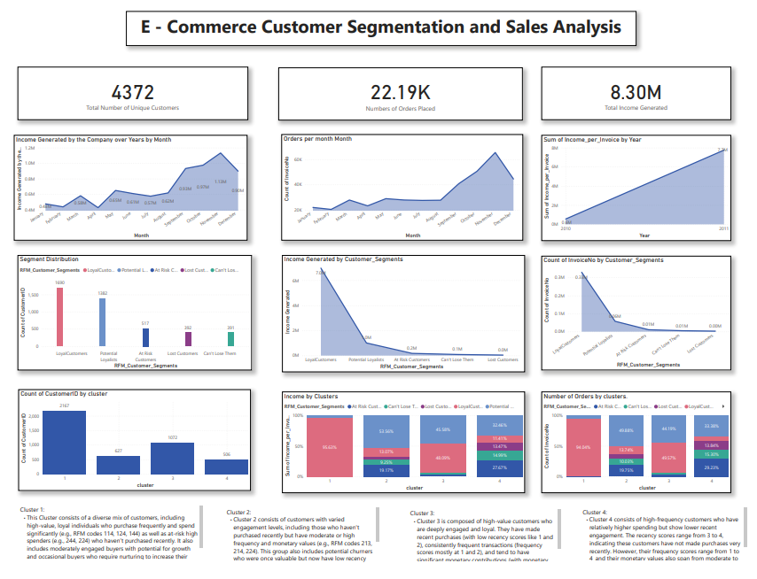

Slide 31
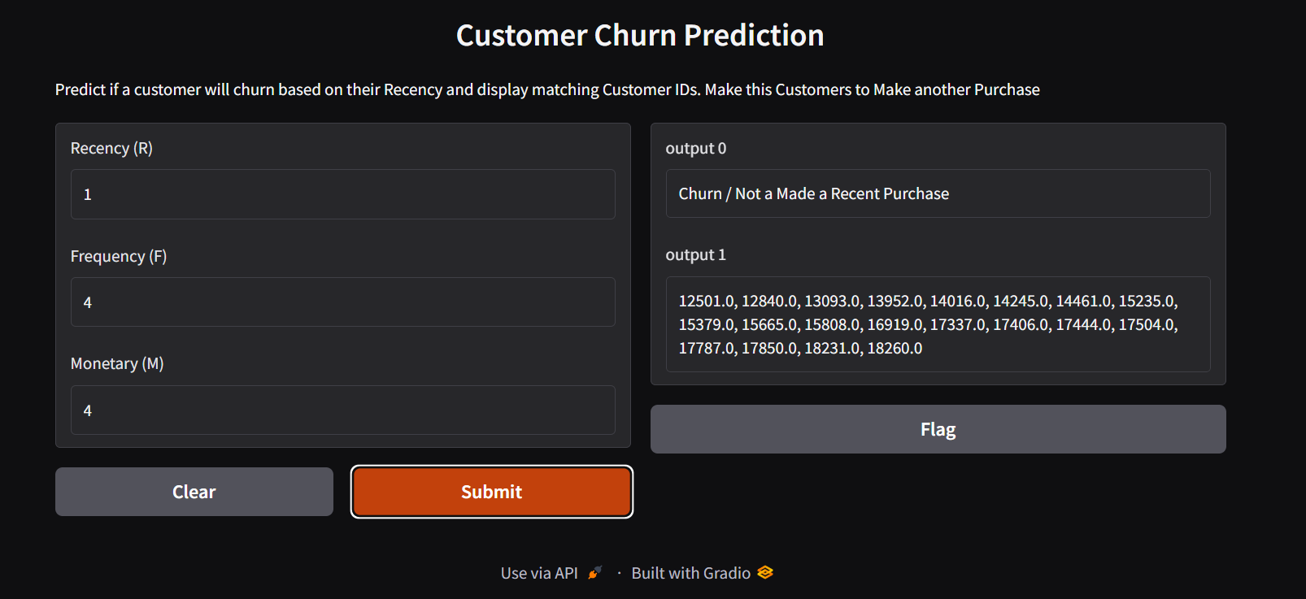

Slide 32
Future Enhancements
Advanced Analytics: Explore machine learning models beyond Random Forest to improve churn prediction accuracy, such as Gradient Boosting Machines (GBM) or Neural Networks. Utilize predictive analytics to identify emerging trends and adapt strategies proactively.
Real-time Customer Engagement: Develop real-time analytics dashboards to monitor customer interactions and identify churn signals immediately. Implement automated customer communication systems for timely outreach to high-risk customers.
Customer Review Analysis: Implement advanced Natural Language Processing (NLP) techniques to analyze customer feedback and sentiment. Integrate insights from reviews to refine product offerings and customer service strategies.

Slide 33
Conclusion
In summary, our analysis has provided valuable insights into customer behavior, segmentation, and churn prediction. By leveraging clustering techniques and machine learning models, specifically Random Forest, we have effectively identified distinct customer segments and key drivers of churn.
The actionable insights derived from this analysis enable tailored marketing strategies, enhancing customer engagement and retention. Implementing targeted interventions for high-risk segments can significantly reduce churn rates, yielding substantial ROI.

Slide 34
Questions ???

Slide 35
Thank You!

